Slide 1
Data Analytics (Sales Dataset – Kaggle)
By: Jaavanika L
Email: ljaavanika01@gmail.com

Slide 2
Sales and Profit Over Time
Chart Type: Dual Axis Line Graph Objective: Track trends in Sales and Profit across time Steps:
Create Profit using: Sales_Amount - (Unit_Cost * Quantity_Sold)
Drag Sale_Date to Columns (Month)
Add Sales_Amount and Profit to Rows
Set dual axis → Synchronize → Line chart for both
Add filters: Region, Sales_Rep, Product_Category
KPIs:
Monthly Sales Trend
Monthly Profit Trend
Compare performance over time

Slide 3
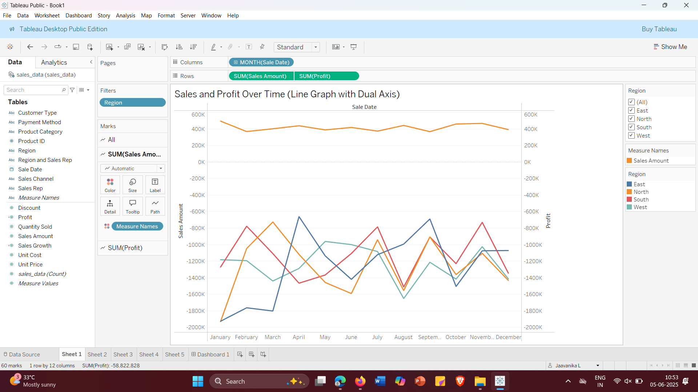

Slide 4
Sales by Region and Sales Rep
Chart Type: Bar Chart Objective: Compare total sales by reps across regions Steps:
Drag Sales_Rep to Columns
Drag Sales_Amount to Rows
Color by Region
Add filters: Region, Sales_Rep → Show Filter
Enable data labels for clarity
KPIs:
Sales per Representative
Regional sales distribution
Identify top performers

Slide 5
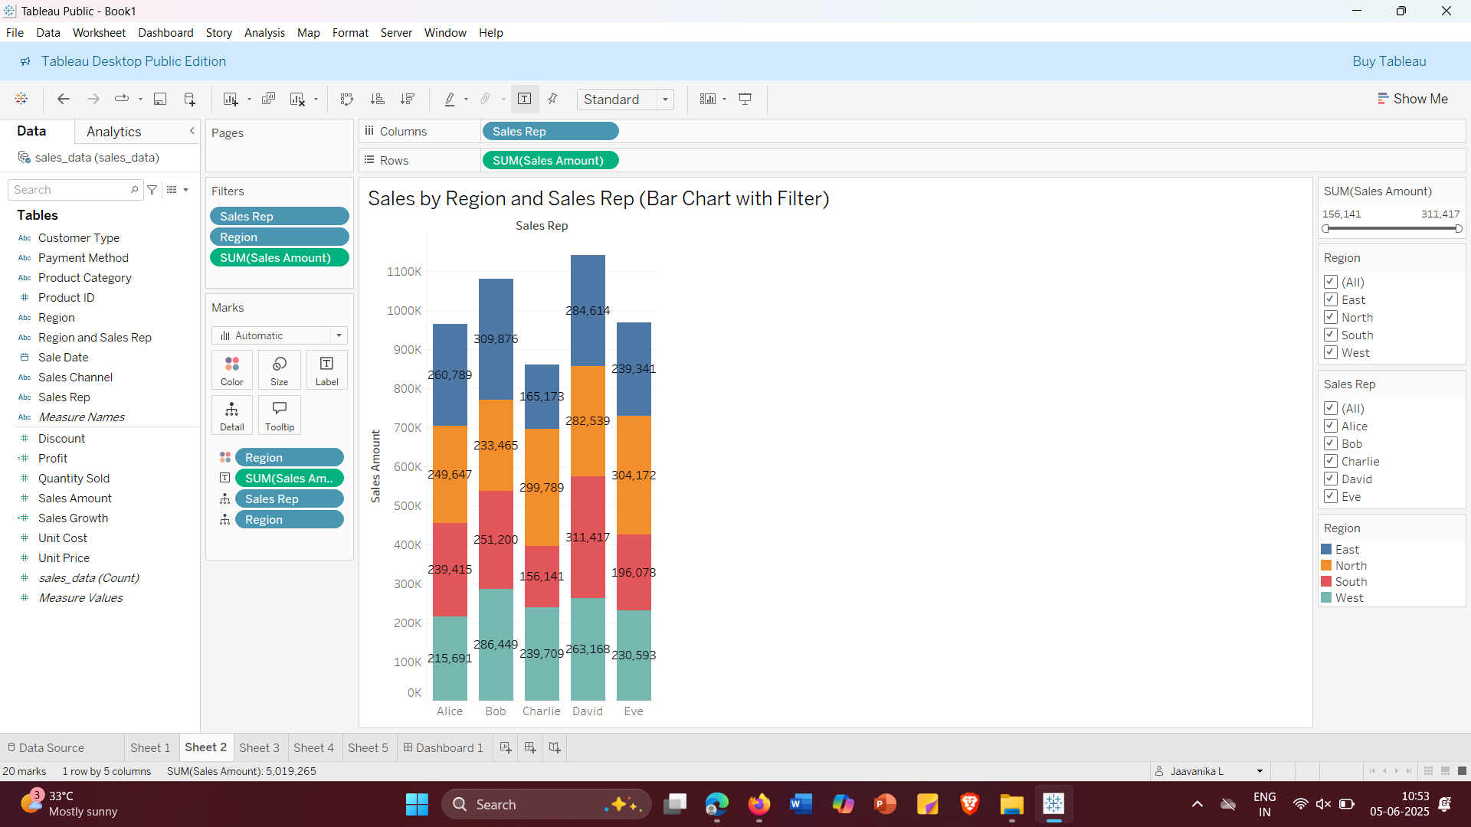

Slide 6
Category-Wise Sales and Profit
Chart Type: Pie Chart Objective: View contribution of each category to sales/profit Steps:
Drag Product_Category to Color and Label
Drag Sales_Amount to Angle
Drag Profit to Tooltip
Sort by descending sales
Add filter: Product_Category
KPIs:
Sales share by category
Profitability by category
Focus areas for marketing

Slide 7
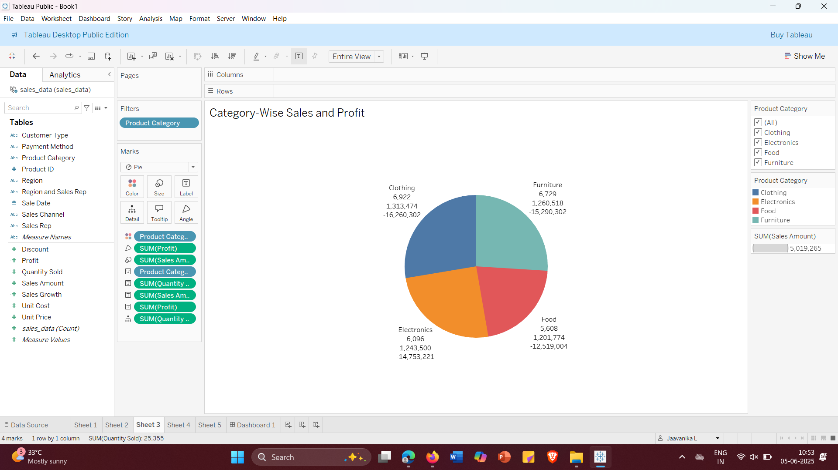

Slide 8
Sales Funnel by Sales Channel and Payment Method
Chart Type: Horizontal Bar / Funnel-style chart Objective: Visualize conversion from channels to payment Steps:
Drag Sales_Channel to Rows
Drag Sales_Amount to Columns
Add Payment_Method to Color
Add filters: Sales_Channel, Payment_Method
KPIs:
Sales by channel
Popular payment modes
Customer journey overview

Slide 9
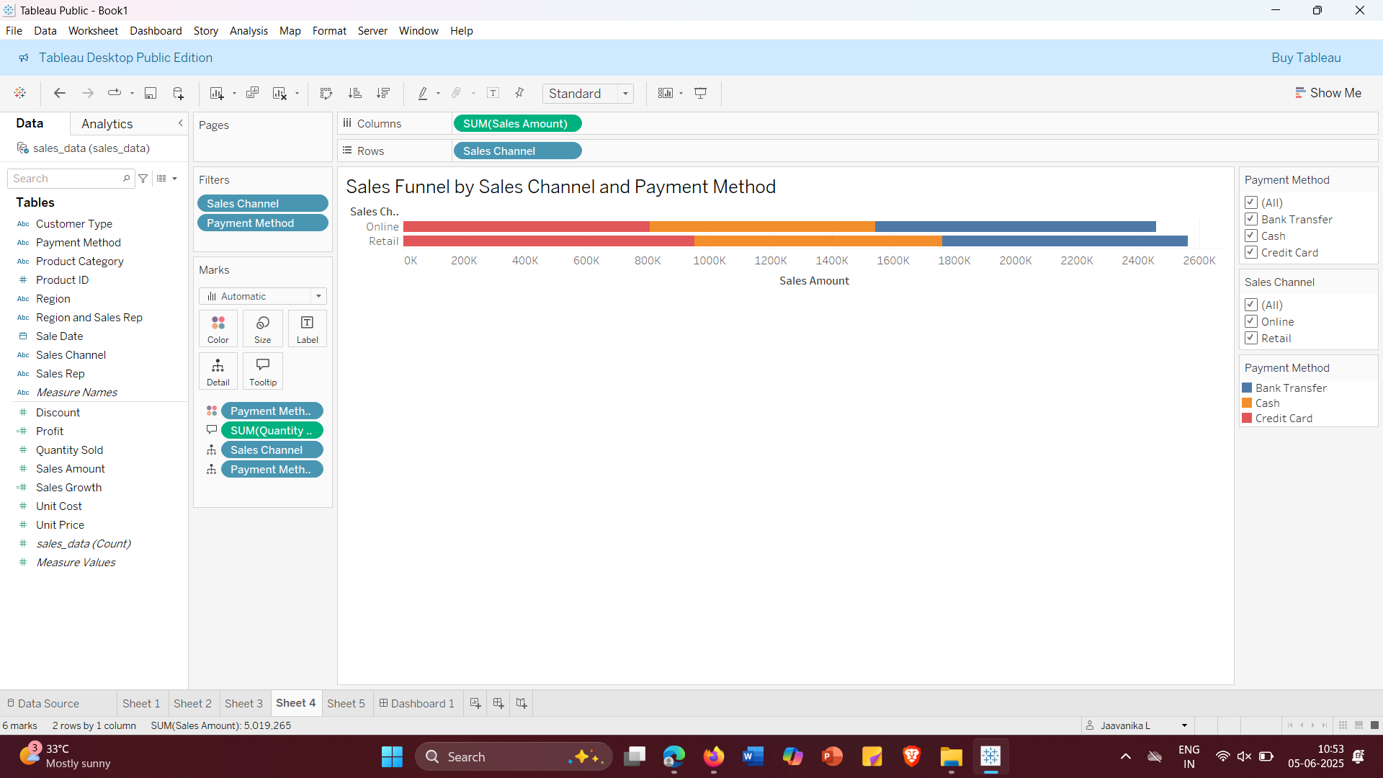

Slide 10
Discount vs Sales Bubble Chart
Chart Type: Bubble Chart Objective: Understand how discounts impact sales and profit Steps:
Discount → Columns
Sales_Amount → Rows
Quantity_Sold → Size
Profit → Color
Set Marks to Circle
Filters: Region, Product_Category
KPIs:
Impact of discounting on revenue
Sales volume vs profitability
Best discount range for profit

Slide 11
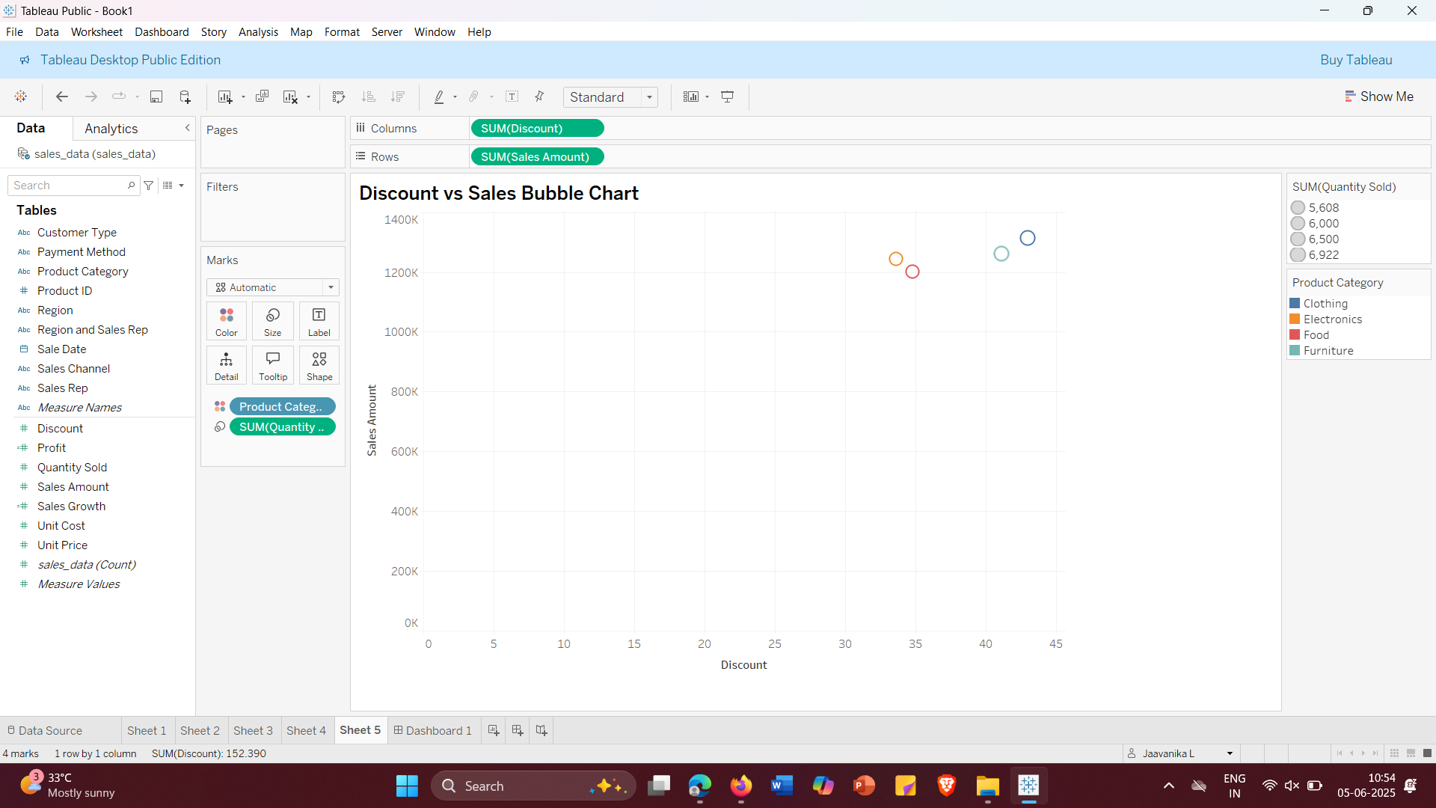

Slide 12
Created Dashboard

Slide 13
